Slide 1

DATASET OVERVIEW
Dataset Used
Apple Inc. (AAPL) Historical Stock Data
Period: June 2021 – June 2026
Features: Date, Open Price, Close Price, High Price, Low Price, and Trading Volume

Slide 2
PYTHON TECHNIQUES APPLIED
Data Cleaning and Preprocessing
Handling Missing Values
Date-Time Manipulation
Feature Engineering
Grouping and Aggregation
Data Transformation using Pandas

Slide 3
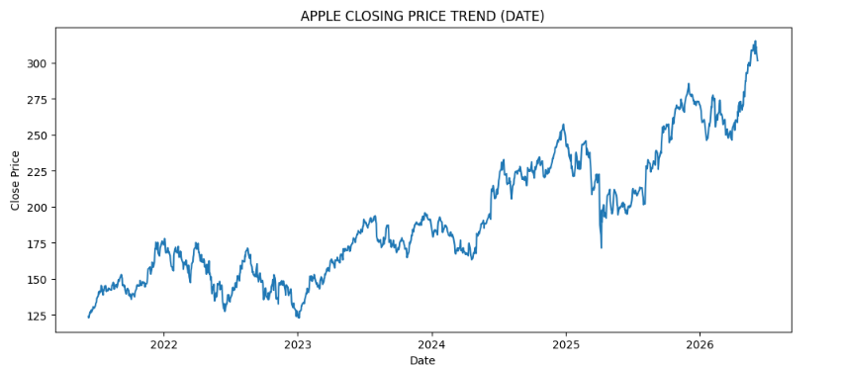
CLOSING PRICE TREND
How has Apple's Stock Price Changed Over the Last 5 Years?
Insight:
Apple's stock price generally increased from 2021 to 2026 despite temporary declines, showing strong long-term growth.
Recommendation:
Long-term investors may benefit from a buy-and-hold strategy as the stock maintained an overall upward trend.

Slide 4
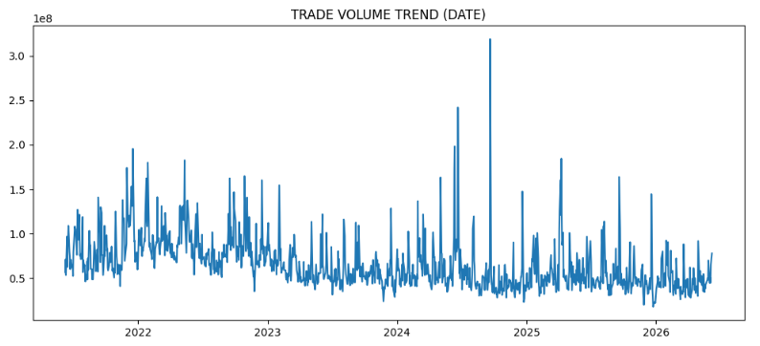
TRADING VOLUME TREND
How Active Were Investors In Trading Apple Shares?
Insight:
Trading volume fluctuated throughout the period, but the stock price continued to rise, indicating sustained investor confidence.
Daily volume mostly ranged between 50M–100M shares.
Several spikes exceeded 200M shares.
Recommendation:
Investigate dates with unusual volume spikes. They may be linked to major company or market events.

Slide 5
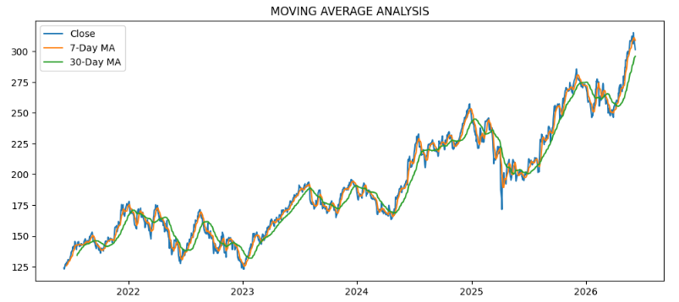
MOVING AVERAGE ANALYSIS
What is the Overall Direction of Apple's Stock?
Insight:
The 7-Day and 30-Day Moving Averages trended upward, confirming a strong long-term bullish trend despite temporary periods of weakness like in 2022 and 2025
Recommendation:
Focus on the long-term trend rather than reacting to short-term price fluctuations.

Slide 6
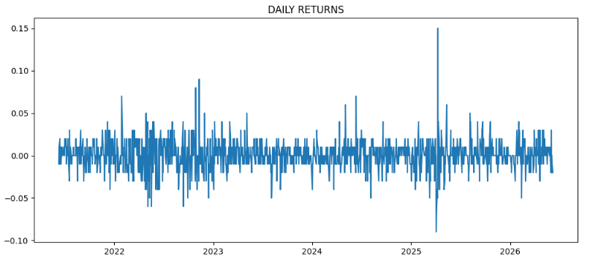
DAILY RETURN ANALYSIS
How much did Apple's stock gain or lose on a daily basis?
Insight:
Daily returns fluctuated around zero, with most gains and losses remaining relatively small, indicating stable performance.
Recommendation:
Avoid decisions based on a single day's return. Consider volume and market news alongside returns.

Slide 7
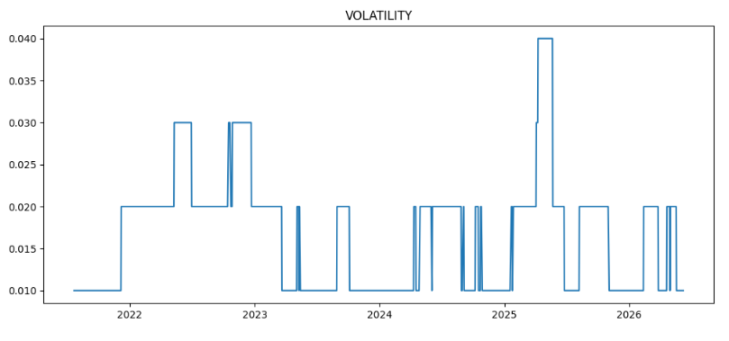
VOLATILITY ANALYSIS
How stable or risky was Apple's stock over time?
Insight:
Volatility remained moderate for most periods.
A few spikes occurred, especially around 2025.
The stock maintained its long-term upward trend.
Recommendation:
Pay closer attention during periods of high volatility, as they may signal increased risk and uncertainty.

Slide 8
KEY FINDINGS AND RECOMMENDATION
Key Findings
Apple maintained a strong long-term upward trend.
Investor confidence remained strong despite fluctuations in trading activity.
Moving averages confirmed sustained growth.
Daily returns showed generally stable performance.
Volatility spikes were temporary and did not change the overall trend.
Recommendation
Use a combination of price trends, volume, moving averages, daily returns, and volatility when evaluating stock performance rather than relying on a single indicator.

